Slide 1
Lesson 2
Web Applications Development Platforms

Slide 2
Session Learning Outcomes
At the end of this Topic, the learner should be able to:
Identify the most popular web application development platforms
Explain the term web development Framework
Differentiate between server side and Client Side programming
Describe the principle of various Web software Frameworks
Explain the principles behind the MVC software pattern
Describe how MVC may be used with different software platforms such as C#, PHP, Java and Python

Slide 3
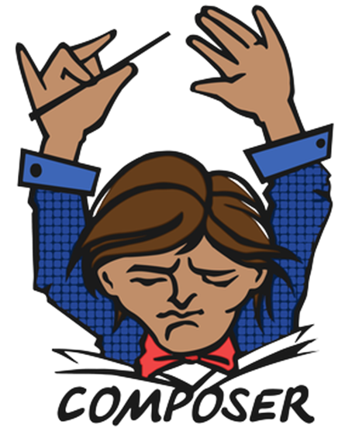
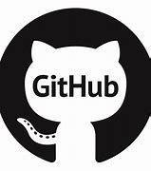
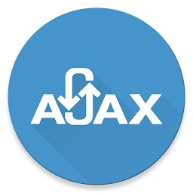
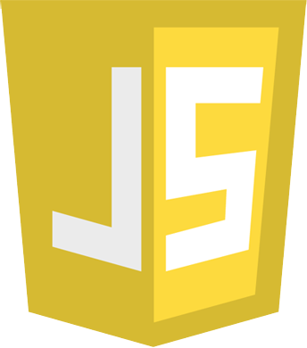
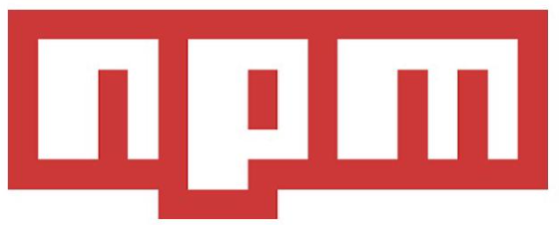
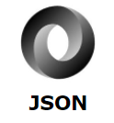

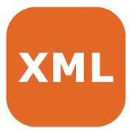
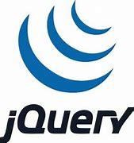
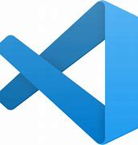
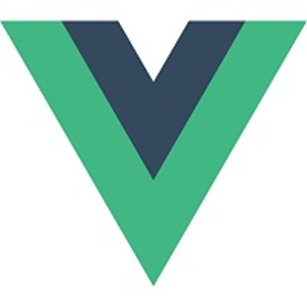
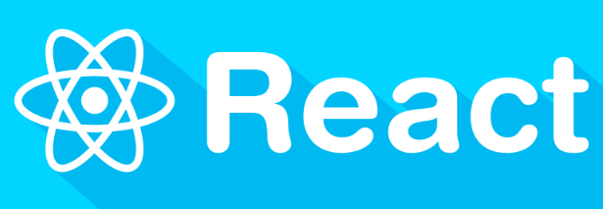

Web App Platforms

Slide 4
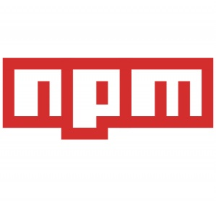
What is npm?
Stands for node package manager
The world's largest Software Library (Registry)
npm is also a software Package Manager and Installer
The registry contains over 800,000 code packages.
Open-source developers use npm to share software.
npm is installed with Node.js
This means that you have to install Node.js to get npm installed on your computer.

Slide 5
npm(cont.)
The name npm (Node Package Manager) stems from when npm first was created as a package manager for Node.js.
All npm packages are defined in files called package.json.
The content of package.json must be written in JSON.
At least two fields must be present in the definition file: name and version.

Slide 6

What is GitHub?
GitHub is a code hosting platform for collaboration and version control.
GitHub lets you (and others) work together on projects.

Slide 7
GitHub essentials
GitHub essentials are:
Repositories
Branches
Commits
Pull Requests
Git (the version control software GitHub is built on)

Slide 8
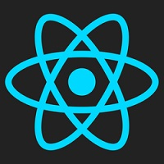
What is React?
React is a JavaScript library created by Facebook
React is a User Interface (UI) library
React is a tool for building UI components

Slide 9
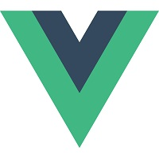
What is Vue.js?
Vue.js lets you extend HTML with HTML attributes called directives
Vue.js directives offers functionality to HTML applications
Vue.js provides built-in directives and user defined directives

Slide 10
What is Visual Studio Code?
It is a popular open-source IDE or editor for any programing language, name it:PHP,Javascript,Python,Ruby etc.
It supports Windows, Linux,macOS.
Visual Studio Code Key features
Debugging
Included GitHub support
Syntax highlight
Extend plugin support
Inbuilt Debug Support
Git Plugin
SSH integration
Terminal
Code Snippets
Code refactoring

Slide 11
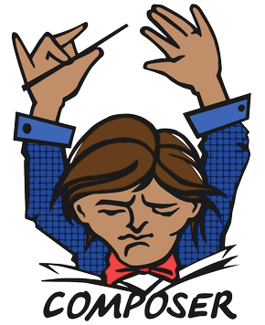
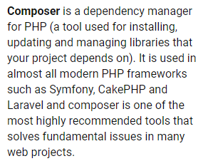
What is Composer?
Composer is a tool for dependency management in PHP. It allows you to declare the libraries your project depends on and it will manage (install/update) them for you.

Slide 12
Web Application Framework
Web Application Frameworks are sets of program libraries, components and tools organized in an architecture system allowing developers to build and maintain complex web application projects using a fast and efficient approach.
Web Application Frameworks are designed to streamline programming and promote code reuse by setting forth folder organization and structure, documentation, guidelines and libraries (reusable codes for common functions and classes).

Slide 13
Front End & Back End Development
Front-end web development, also known as client-side development is the practice of producing HTML, CSS and JavaScript for a Web Application.
Backend development also known as server side programming is the code that connects the front end to a database, manages user connections, and powers the web application itself.

Slide 14
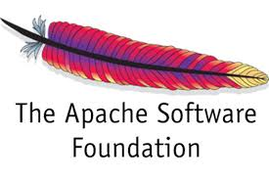
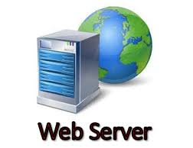
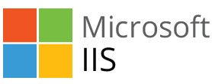
Web Server
A dedicated computer that stores, processes and delivers web pages to clients
A software that uses HTTP to serve the files that form Web pages to users, in response to their requests.
Our interest in this course is on web server software's

Slide 15
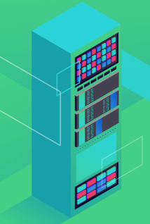
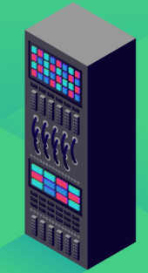
Nginx vs Apache

Slide 16
Nginx vs Apache
Nginx and Apache are popular web servers used to deliver web pages to a user’s browser.
Apache was released first in 1995, then came Nginx in 2004.
Both are used by many companies around the globe for hosting .
Nginx market share has been steadily growing for years.
In some instances, Nginx has a competitive edge in terms of performance.

Slide 17
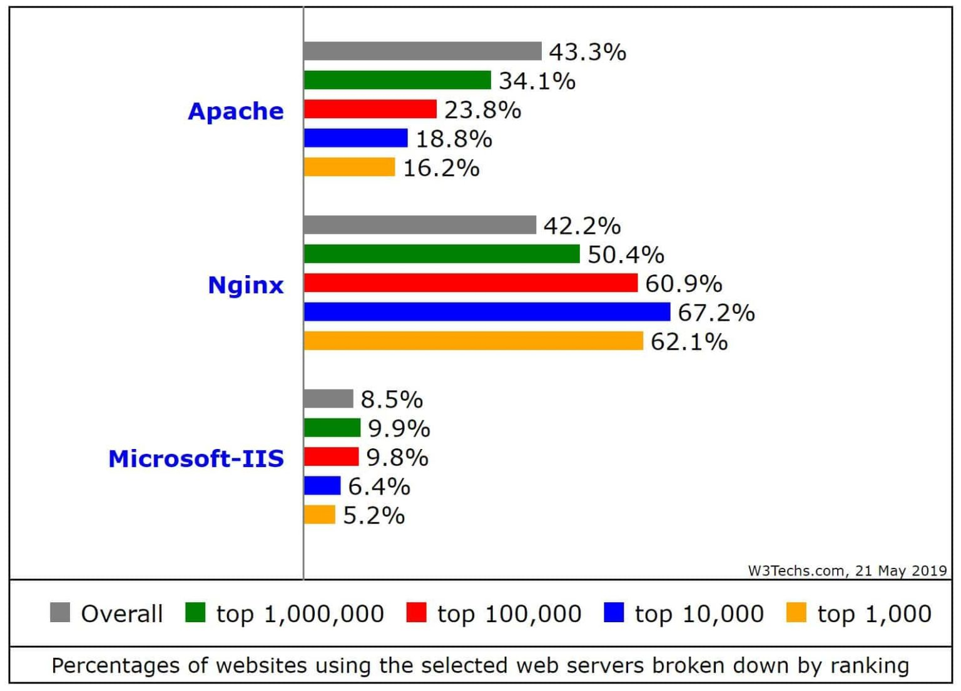
Apache, Nginx vs IIS usage

Slide 18
Apache HTTP Server
Apache is an open-source and free web server software that powers around 46% of websites around the world.
The official name is Apache HTTP Server
Maintained and developed by the Apache Software Foundation.
Apache web server Advantages include
Robustness
Easy to install
Works with all operating systems, all databases and all scripting languages

Slide 19
Common Gateway Interface(CGI)
A standard method used to generate dynamic content on web pages.
Technology that allows web browsers to submit forms to interact with programs on the server.
Used with simple interactive applications.
Can be used with any programming languages e.g.. ASP, PHP, Python & Ruby etc.
CGI applications are often called CGI scripts
Run in the servers and not in the web browser.

Slide 20
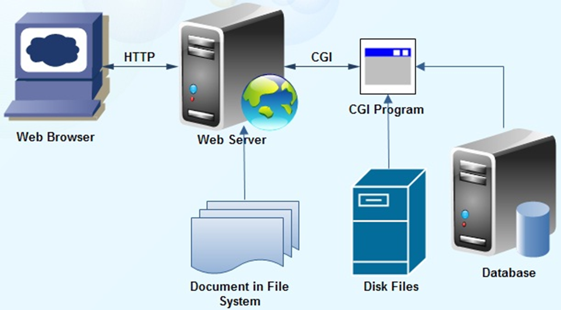
Working of CGI

Slide 21
Client Side vs. Server Side
Website scripts run in one of two places – the client side or the server side.
Sometimes called front end and back end.
The client of a website refers to the web browser that is viewing it.
The server of a website is, of course, the server that hosts it.
Most web coding languages are designed to run on either the server side or the client side.
Client Side Languages:JavaScript,HTML and CSS code.
Server Side Languages: Ruby,PHP,Python etc

Slide 22
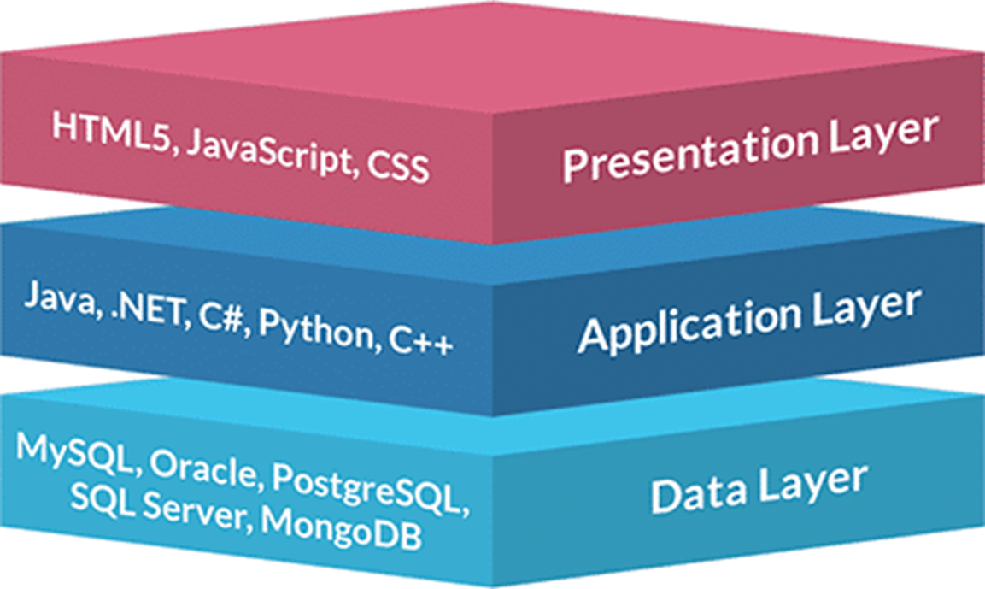
3-Tier Architecture

Slide 23
3-Tier Architecture(cont.)
Presentation Tier- The presentation tier is the front end layer in the 3-tier system and consists of the user interface.
This user interface is often a graphical one accessible through a web browser or web-based application and which displays content and information useful to an end user.
This tier is often built on web technologies such as HTML5, JavaScript, CSS, or through other popular web development frameworks, and communicates with others layers through API calls.
Application Tier- The application tier contains the functional business logic which drives an application’s core capabilities.
It’s often written in Java, .NET, C#, PHP, Python, etc.
Data Tier- The data tier comprises of the database/data storage system and data access layer. Examples of such systems are MySQL, Oracle, PostgreSQL, Microsoft SQL Server, MongoDB, etc.
Data is accessed by the application layer via API calls.

Slide 24
Design Patterns
In Software and Web Engineering, a design pattern is a general reusable solution to a commonly occurring problem in software design.
It is not a finished design that can be transformed directly into code.
it is a description or template for how to solve a problem that can be used in many different situations.

Slide 25
Why use Design Patterns?
Give the developer a selection of tried and tested solutions to work with
Are language neutral and so can be applied to any language that supports object-orientation.
Aid communication by the very fact that they are well documented and can be researched if that is not the case.
Have a proven track record as they are already widely used and thus reduce the technical risk to the project.
Are highly flexible and can be used in practically any type of application or domain

Slide 26
Types of Design Patterns
Examples include:
Factory pattern
Singleton pattern
Strategy pattern
Front Controller Pattern
Model-View-Controller Pattern

Slide 27
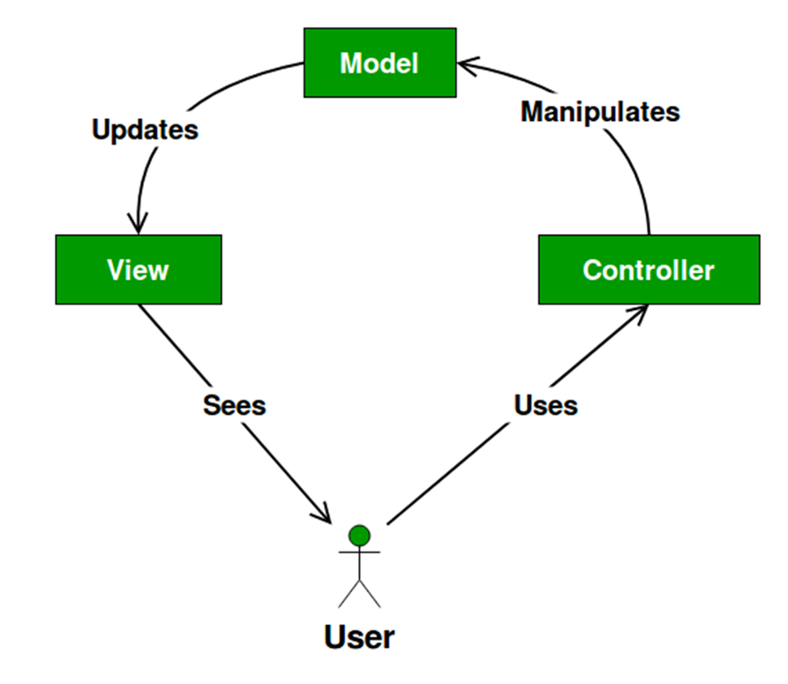
Model View Controller Pattern
Software development has undergone many changes over the years.
Out of these many changes, MVC is considered the biggest of all.
MVC stands for Model-View-Controller.
Used for implementing a user interface on computers.
A supportive architecture that works irrespective of what language you use for development.
The core of the application is represented as Model, whereas the view displays and the controller handles the input.
The MVC separation helps one to manage complex applications because one can focus on one aspect at a time.

Slide 28
Model View Controller Pattern(cont.)
Models serve as a data access layer where data is fetched and returned in formats usable throughout your application.
Controllers handle the request, process the data returned from models and load views to send in the response.
Views are display templates (markup, xml, CSS, etc) that are sent in the response to the web browser.
MVC is the most common architectural pattern used in the popular with both front end and back end frameworks.

Slide 29
MVC Frameworks
An MVC framework is a software containing libraries. MVC provides “the skeleton of an application that can be customized by an application developer” Like software libraries, software frameworks aid the software developer by containing source code that solves problems for a given domain and provides a simple API.
The goal of a framework is to allow designers and developers to focus on building the unique features for their project, rather than re-inventing the wheel by coding common, familiar features found across many websites and web applications.

Slide 30
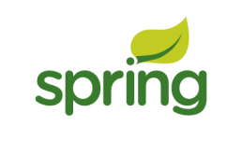


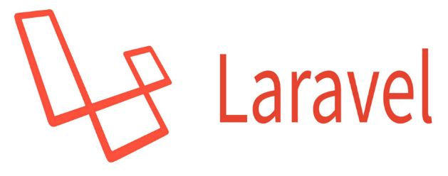
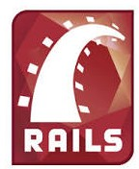
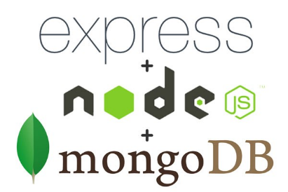
MVC Web Frameworks Examples

Slide 31
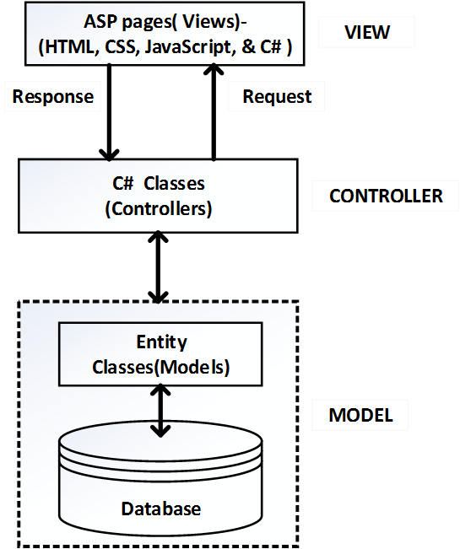
MVC with asp.net
The system can be implemented in ASP.NET using the ASP.NET MVC 4 framework.
The Razor view engine can be used for the views.
C# controller classes for the controllers.
C# entity classes for the models.
The Razor view engine combines C# code and HTML tags to produce dynamic web pages.
The controllers are written C# language to process incoming requests, perform operations on the model, and select views to render to the user.
The entity classes represent database objects and they are responsible for implementing the business logic.

Slide 32
asp.net Tools
The following tools can be used for the implementation in ASP.NET:
Microsoft Visual Studio 2012 IDE for the application development.
ASP.NET MVC 4 Razor view engine for generating the page views
C# programming language for the controllers and models (entity classes)
Microsoft SQL Server 2012 Express Edition for the database development.
Internet Information Service (IIS 7.0) for the web server

Slide 33
MVC with PHP
MVC design pattern can be used to develop the system in PHP.
The views can be developed using PHP web pages.
The controllers can be developed using PHP classes (.php)
The models can be developed using Entity Classes which are also PHP classes (.php).

Slide 34
PHP Tools
The system can be implemented in PHP using the Laravel, Yii or even CakePHP frameworks.
All the three are free, open-source and rapid application development frameworks for PHP.
Laravel templates can be used for the views Laravel controller classes for the controllers and Laravel entity classes for the models.
The Laravel templates combine PHP language and HTML tags to produce dynamic web pages.
Laravel controllers are classes that are written in PHP language to handle HTTP requests.
The entity classes represent database objects and they are responsible for implementing the business logic.

Slide 35
MVC with JAVA
The model contains the business logic that processes the application’s data.
It also stores or retrieves data to or from the database.
The view displays information to the user and the controller handles user interactions and input.
The views is developed using JSP web pages(.jsp), the controllers are developed using Java servlets (*.java) and the models are developed using Enterprise Java Beans (EJB) and the Java Persistence API (JPA).

Slide 36
Java Tools
The following tools can be used for the implementation in Java:
NetBeans IDE 8.0 for the application development.
JSP for generating the page views.
Java programming language for the controllers (servlets) and models (Enterprise Java Beans).
MySQL Server 7.0 for the database development.
Apache Tomcat/GlassFish Server 5.0 for the web server.

Slide 37
MVC/MVT with Python
Python frameworks includes Django and Flask
Django prefers to use its own logic implementation in its web app and hence its framework handles all the controller parts by itself.
Hence Django implements a different kind of architecture called MVT (Model – View – Template) architecture.
MVT architecture is the software design pattern used by the Django web framework.
MVT stands for Model – View – Template.

Slide 38
Django MVT architecture
Model: Acts as the interface of your data & is responsible for maintaining data. It is the logical data structure behind the entire application and is represented by a database(MYSQL or Postgres).
View: The View is the user interface that is presented into in your browser when you render a website. It is represented by HTML/CSS/Java Script and Jinja files. The View is used to execute the business logic and to interact with a model for data carriage and template rendering.
Template: Consists of static parts of the desired HTML output as well as some special syntax describing how dynamic content will be inserted

Slide 39
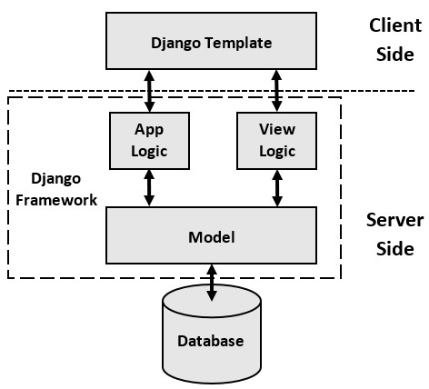
Django MVT architecture

Slide 40
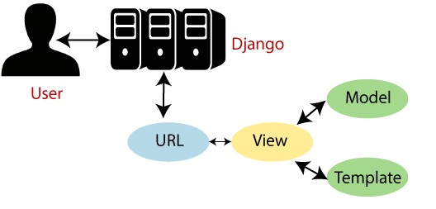
Django MVT architecture(cont.)
Here as shown in the above picture
The user sends a URL request for a resource to Django.
Django framework then searches for the URL resource.
If the URL path links up to a View, then that particular View is called.
The View will then interact with the Model and retrieve the appropriate data from the database.
The View then renders back an appropriate template along with the retrieved data to the user.

Slide 41
The end
Thank you

